Slide 1
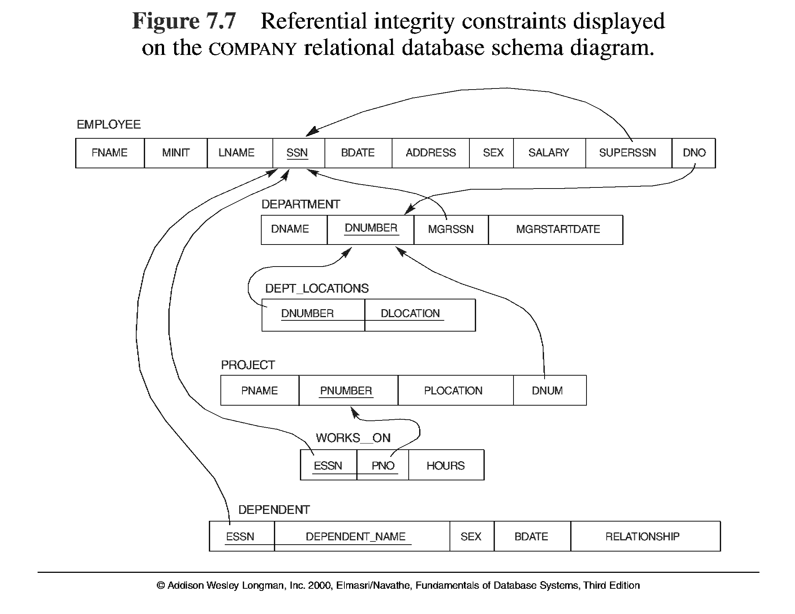

Slide 2
Relational Algebra
The basic set of operations for the relational model is known as the relational algebra. These operations enable a user to specify basic retrieval requests.
The result of a retrieval is a new relation, which may have been formed from one or more relations. The algebra operations thus produce new relations, which can be further manipulated using operations of the same algebra.
A sequence of relational algebra operations forms a relational algebra expression, whose result will also be a relation that represents the result of a database query (or retrieval request).

Slide 3
Unary Relational Operations
SELECT Operation
SELECT operation is used to select a subset of the tuples from a relation that satisfy a selection condition.
It is a filter that keeps only those tuples that satisfy a qualifying condition – those not satisfying the condition are discarded.
The SELECT operation σ _{<selection condition>}(R) produces a relation S that has the same schema as R where the symbol σ (sigma) is used to denote the select operator, and the selection condition is a Boolean expression specified on the attributes of relation R
Example: To select the EMPLOYEE tuples whose department number is four or those whose salary is greater than $30,000 :
σDNO = 4 (EMPLOYEE)
σSALARY > 30,000 (EMPLOYEE)

Slide 4
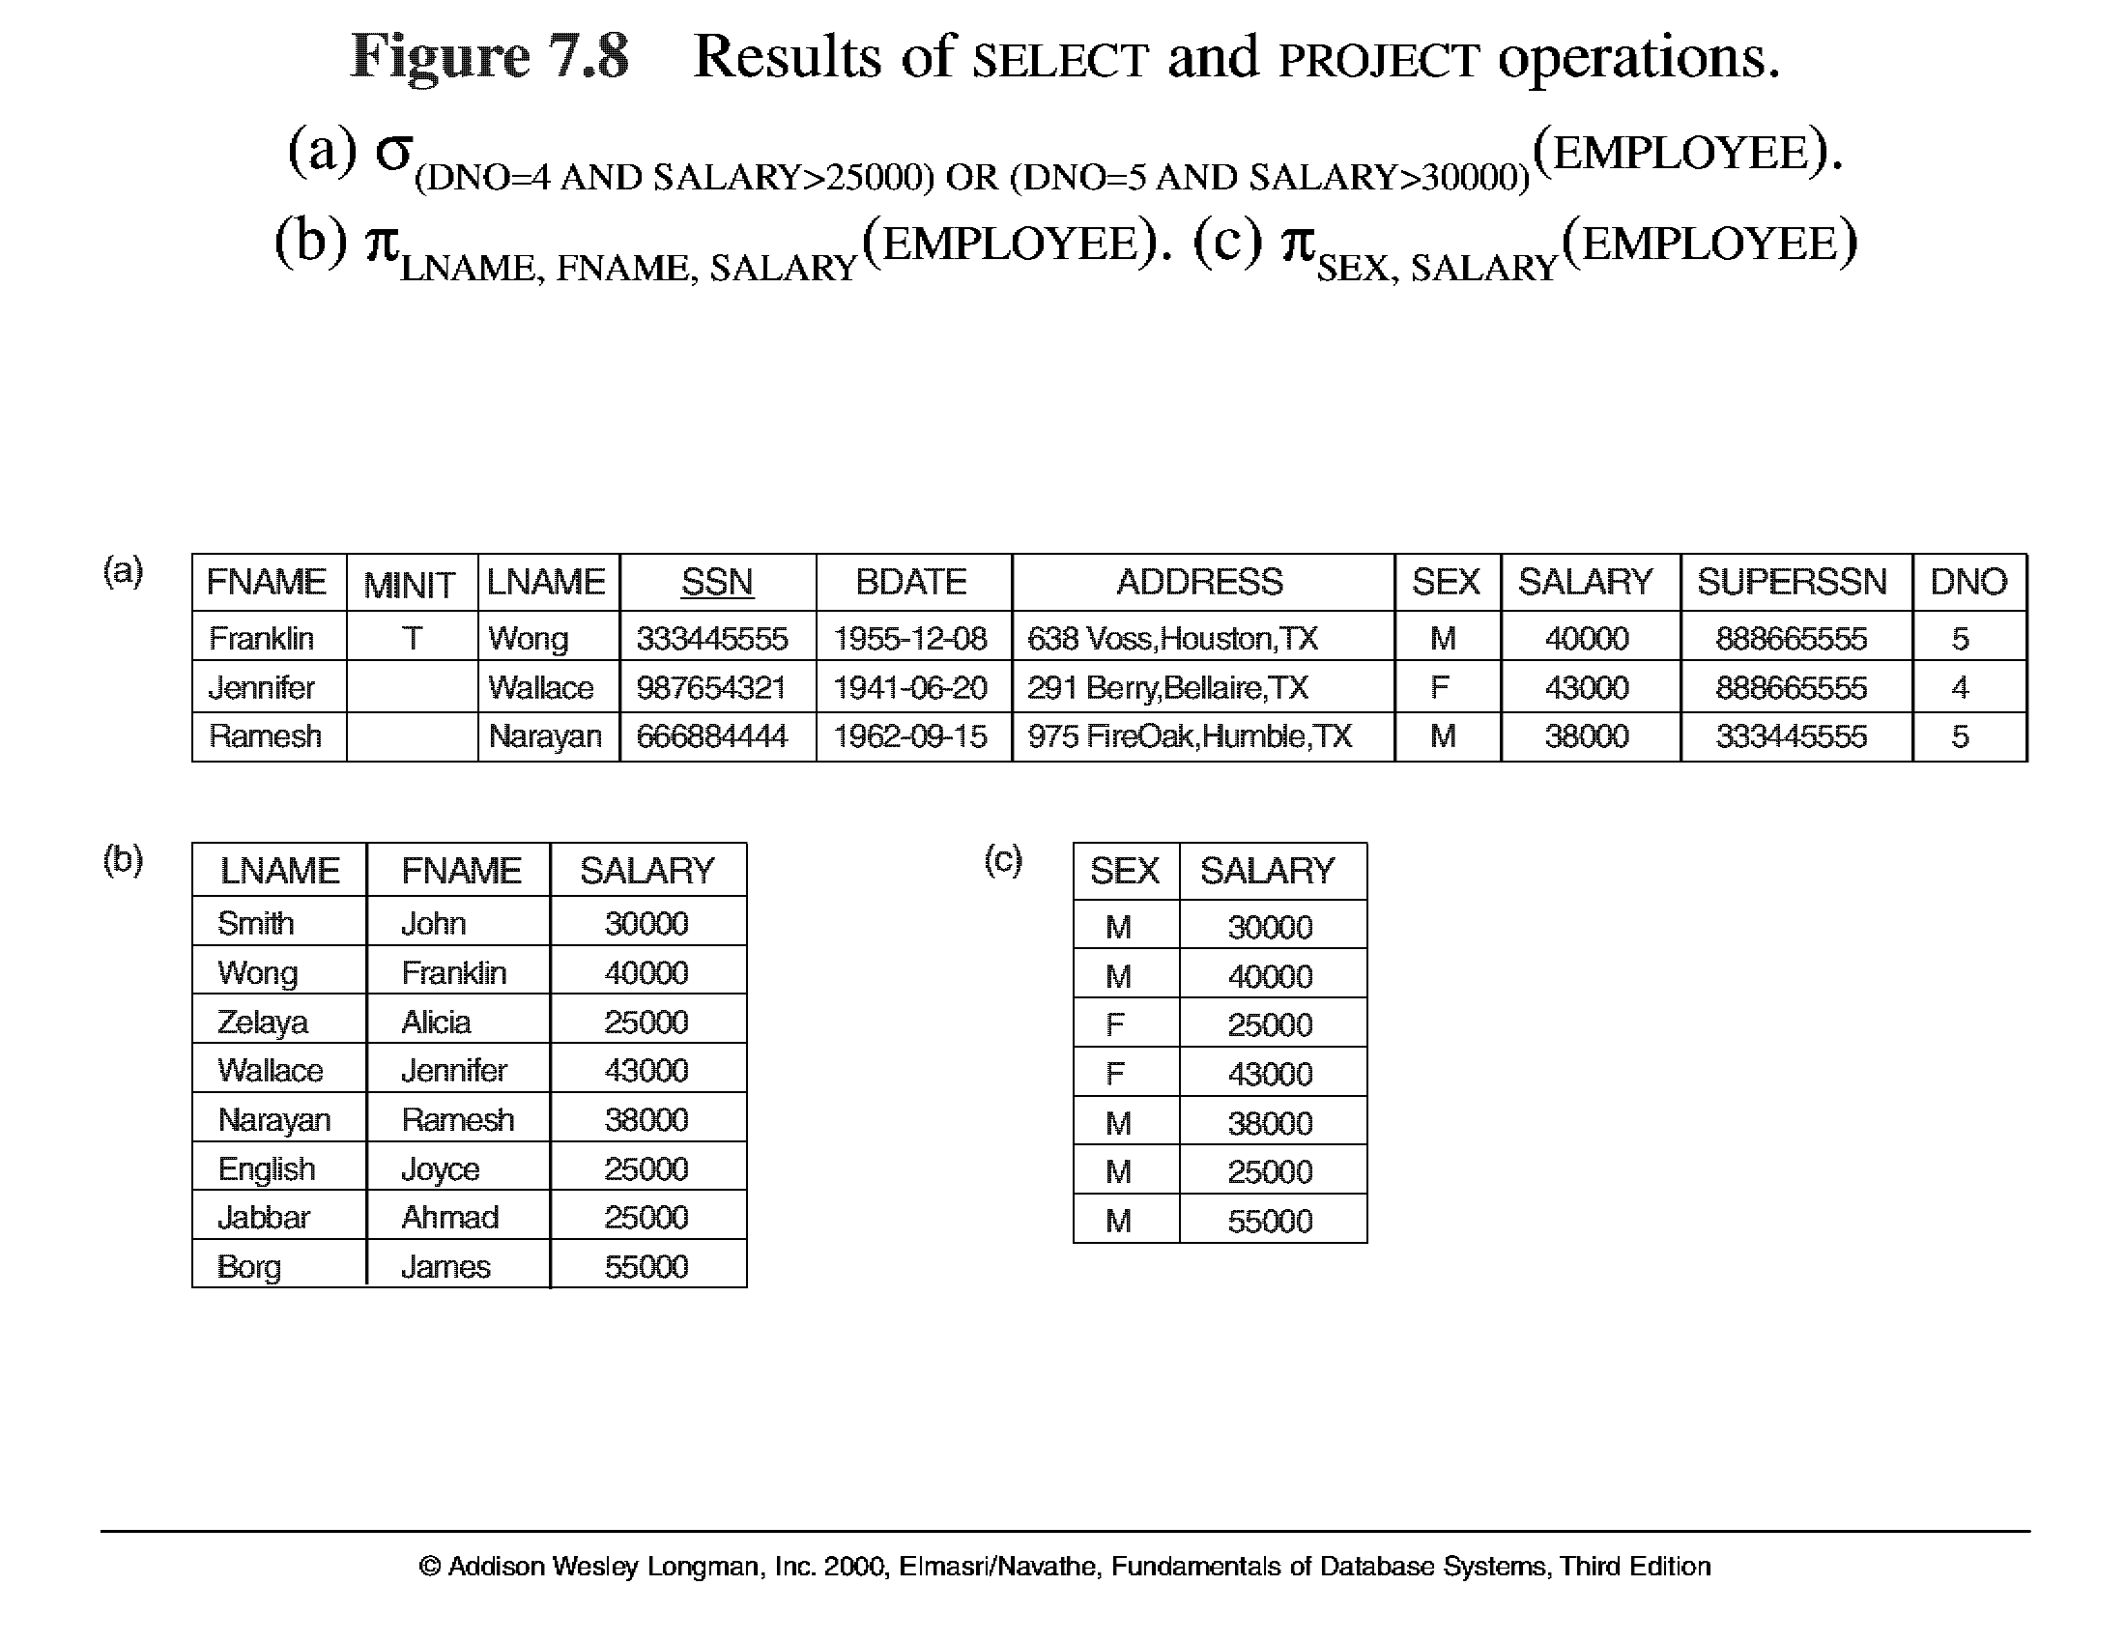
Unary Relational Operations (cont.)

Slide 5
Unary Relational Operations (cont.)
PROJECT Operation
This operation selects certain columns from the table and discards the other columns.
The PROJECT creates a vertical partitioning – one with the needed columns (attributes) containing results of the operation and other containing the discarded Columns.
The general form of the project operation is π<attribute list>(R) where π (pi) is the symbol used to represent the project operation and <attribute list> is the desired list of attributes from the attributes of relation R.
Example: To list each employee’s first and last name and salary, the following is used:
π_{LNAME, FNAME,SALARY}(EMPLOYEE)
The project operation removes any duplicate tuples, so the result of the project operation is a set of tuples and hence a valid relation.

Slide 6
Unary Relational Operations (cont.)
PROJECT Operation Properties
  The number of tuples in the result of projection π _{<list>} (R)is always less or equal to the number of tuples in R.
  If the list of attributes includes a key of R, then the number of tuples is equal to the number of tuples in R.

Slide 7
Unary Relational Operations (cont.)

Slide 8
Unary Relational Operations (cont.)
Rename Operation (cont.)
The rename operator is ρ
The general Rename operation can be expressed by any of the following forms:
ρ _{S (B1, B2, …, Bn )} ( R) is a renamed relation S based on R with column names B₁, B₁, …..B_{n}.
ρ _{S} ( R) is a renamed relation S based on R (which does not specify column names).
ρ _{(B1, B2, …, Bn )} ( R) is a renamed relation with column names B₁, B₁, …..B_{n} which does not specify a new relation name.

Slide 9
Unary Relational Operations (cont.)
Rename Operation (Alternate)
We may want to apply several relational algebra operations one after the other. Either we can write the operations as a single relational algebra expression by nesting the operations, or we can apply one operation at a time and create intermediate result relations. In the latter case, we must give names to the relations that hold the intermediate results.
Example: To retrieve the first name, last name, and salary of all employees who work in department number 5, we must apply a select and a project operation. We can write a single relational algebra expression as follows:
π_{FNAME, LNAME, SALARY}(σ _{DNO=5}(EMPLOYEE))
OR We can explicitly show the sequence of operations, giving a name to each intermediate relation:
DEP5_EMPS ← σ _{DNO=5}(EMPLOYEE)
RESULT ← π _{FNAME, LNAME, SALARY} (DEP5_EMPS)

Slide 10
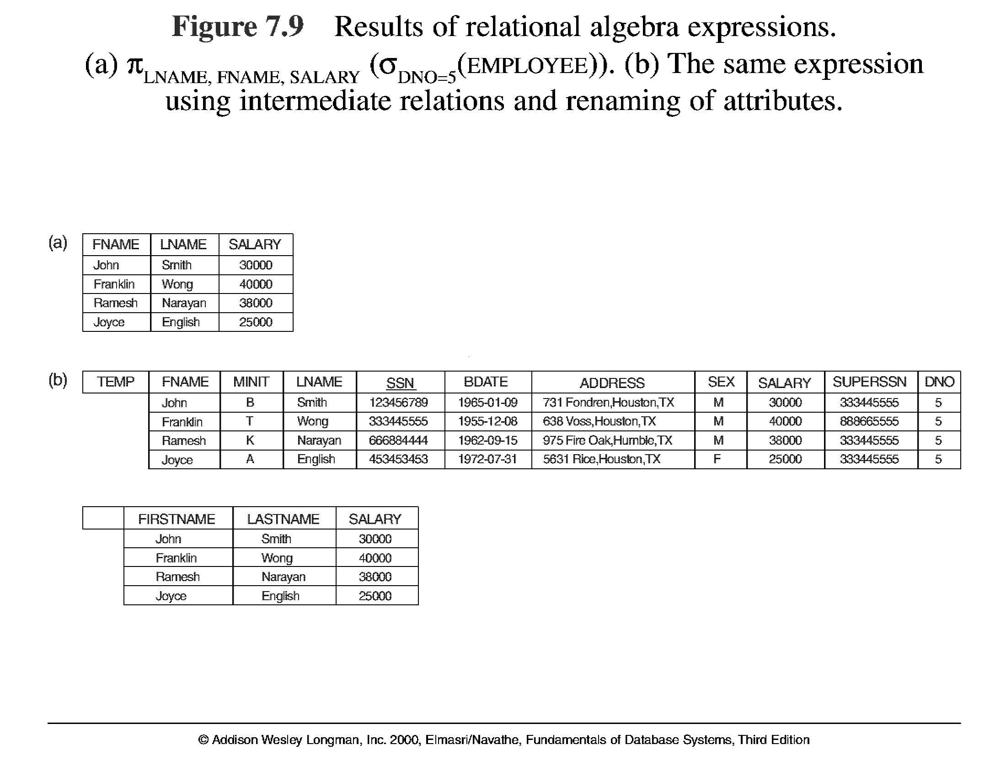
Unary Relational Operations (cont.)

Slide 11
Relational Algebra Operations From Set Theory
CARTESIAN (or cross product) Operation
  This operation is used to combine tuples from two relations in a combinatorial fashion. In general, the result of R(A₁, A₂, . . ., A_{n}) x S(B₁, B₂, . . ., B_{m}) is a relation Q with degree n + m attributes Q(A₁, A₂, . . ., A_{n}, B₁, B₂, . . ., B_{m}), in that order. The resulting relation Q has one tuple for each combination of tuples—one from R and one from S.
  Hence, if R has n_{R} tuples (denoted as |R| = n_{R} ), and S has n_{S} tuples, then
  | R x S | will have n_{R} * n_{S} tuples.
  The two operands do NOT have to be "type compatible”
Example:
  FEMALE_EMPS ← σ _{SEX=’F’}(EMPLOYEE)
  EMPNAMES ← π _{FNAME, LNAME, SSN} (FEMALE_EMPS)
  EMP_DEPENDENTS ← EMPNAMES x DEPENDENT

Slide 12
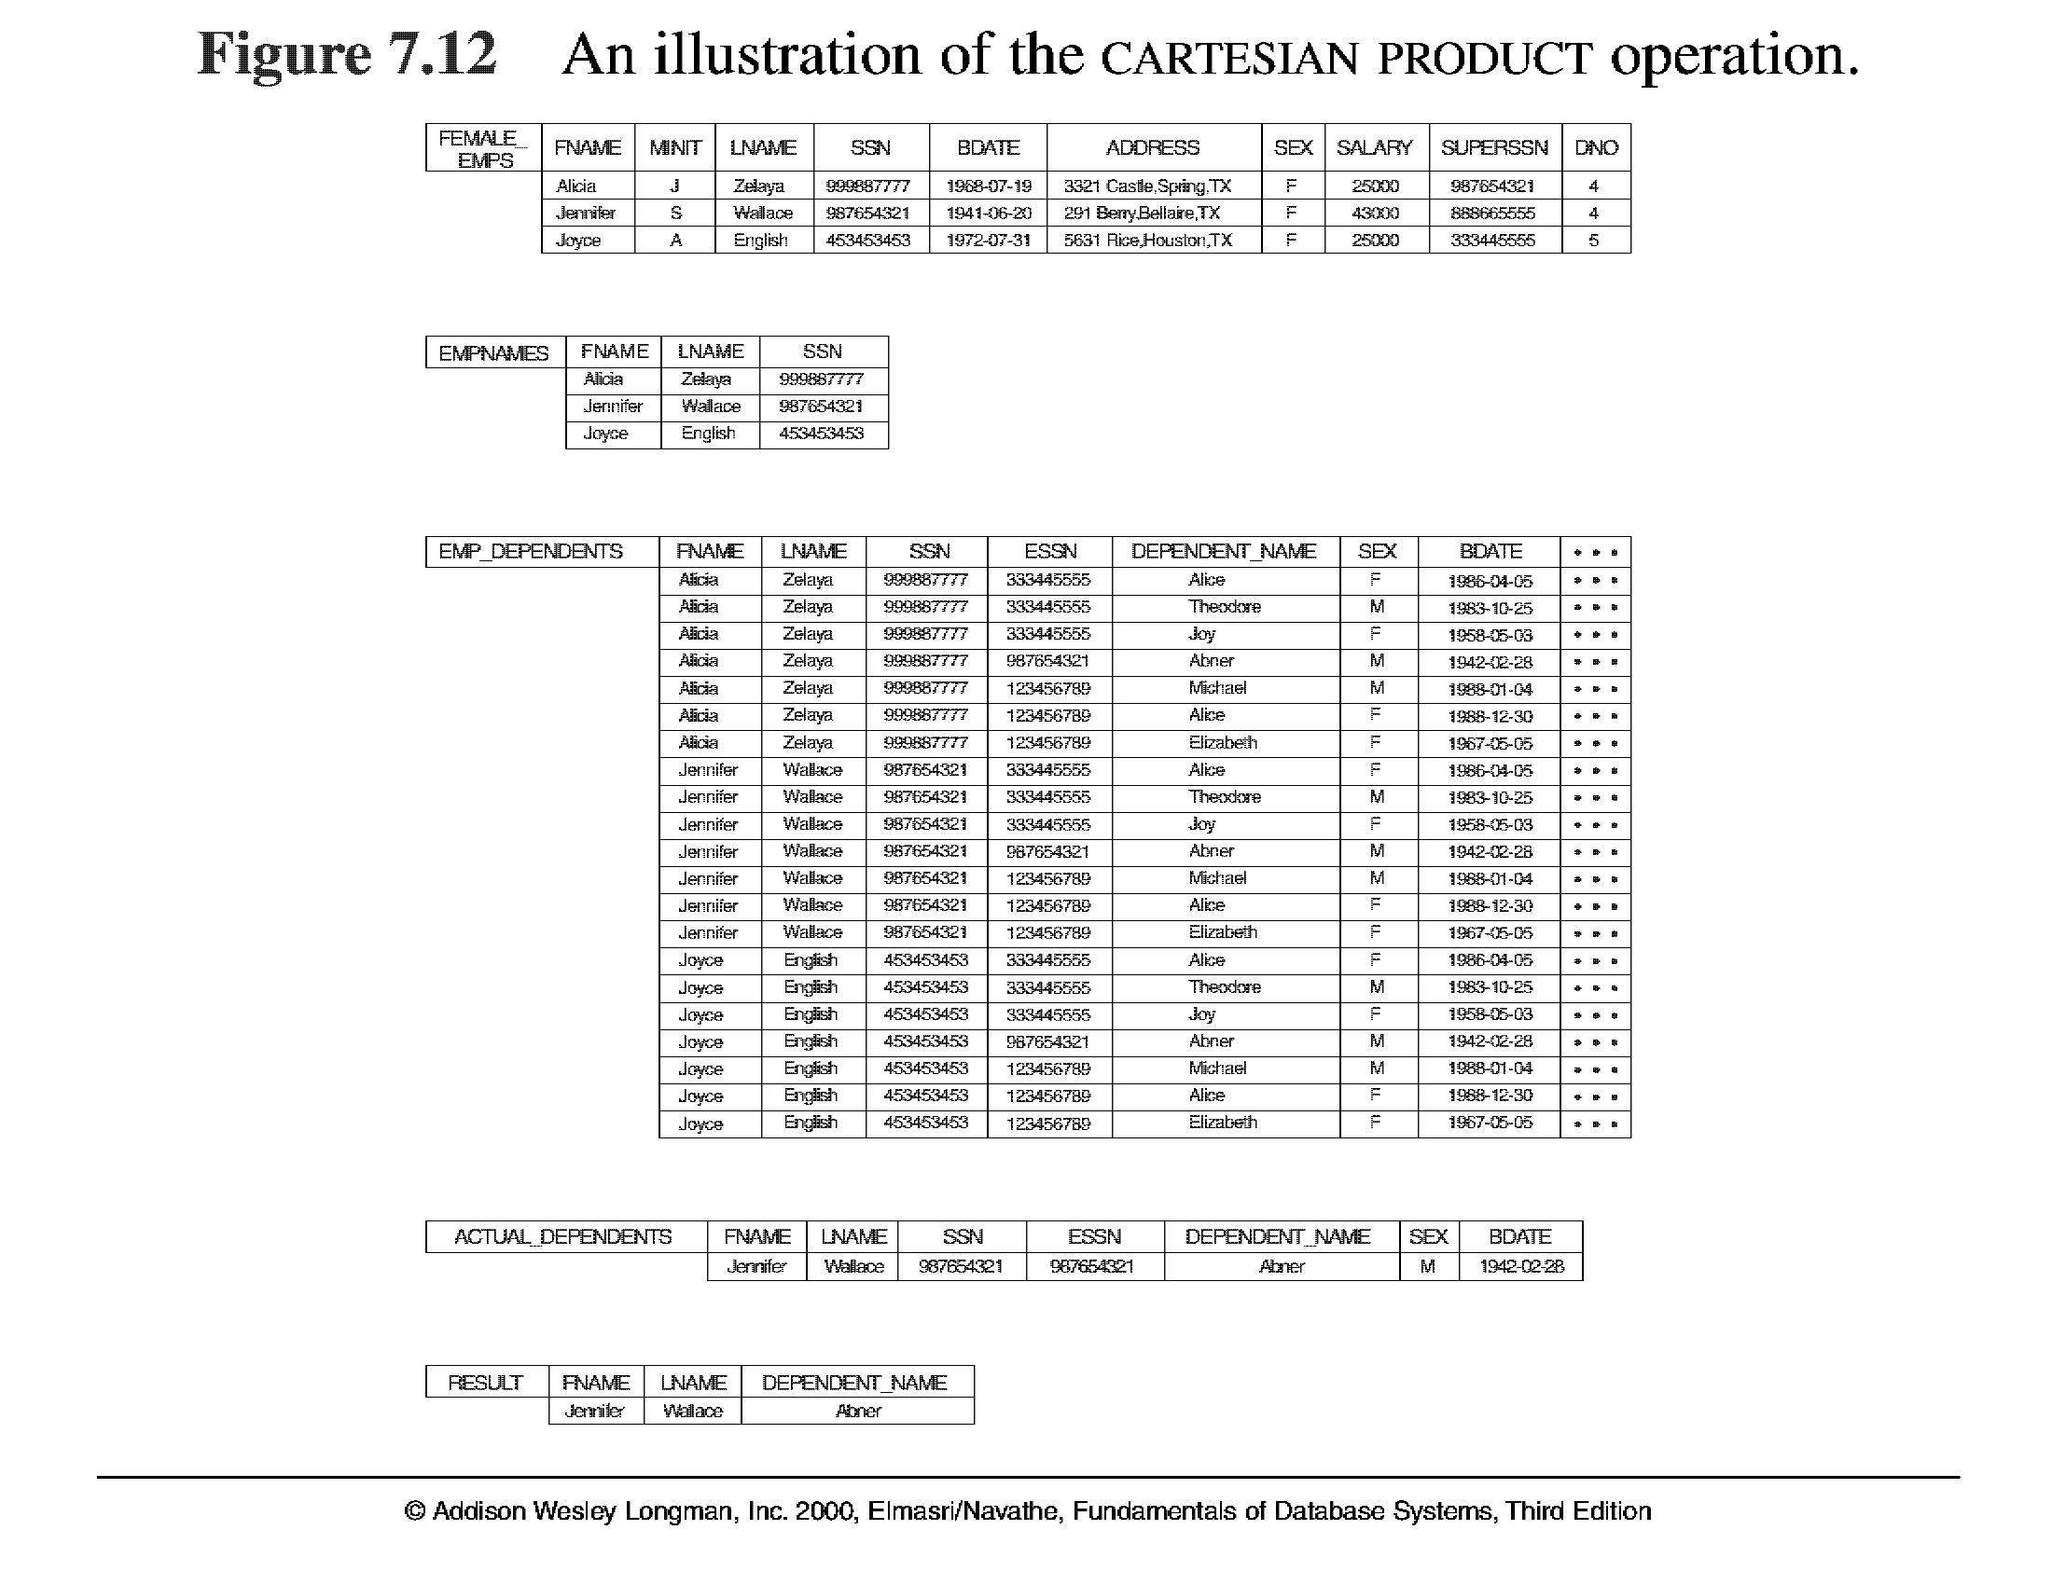
Relational Algebra Operations From Set Theory (cont.)

Slide 13
Binary Relational Operations
Theta JOIN Operation
  The sequence of cartesian product followed by select is used quite commonly to identify and select related tuples from two relations, a special operation, called JOIN. It is denoted by a
  This operation is very important for any relational database with more than a single relation, because it allows us to process relationships among relations.
  The general form of a join operation on two relations R(A₁, A₂, . . ., A_{n}) and S(B₁, B₂, . . ., B_{m}) is:
R _{<join condition>}S
where R and S can be any relations that result from general relational algebra expressions.

Slide 14
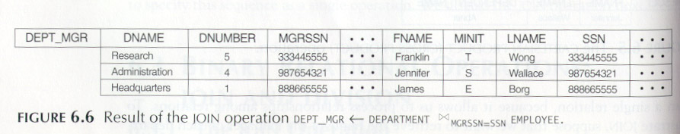
Binary Relational Operations (cont.)
Example: Suppose that we want to retrieve the name of the manager of each department. To get the manager’s name, we need to combine each DEPARTMENT tuple with the EMPLOYEE tuple whose SSN value matches the MGRSSN value in the department tuple. We do this by using the join operation.
DEPT_MGR ← DEPARTMENT _{MGRSSN=SSN} EMPLOYEE

Slide 15
Binary Relational Operations (cont.)
EQUIJOIN Operation
The most common use of join involves join conditions with equality comparisons only. Such a join, where the only comparison operator used is =, is called an EQUIJOIN. In the result of an EQUIJOIN we always have one or more pairs of attributes (whose names need not be identical) that have identical values in every tuple.
The JOIN seen in the previous example was EQUIJOIN.
NATURAL JOIN Operation
Because one of each pair of attributes with identical values is superfluous, a new operation called natural join—denoted by *—was created to get rid of the second (superfluous) attribute in an EQUIJOIN condition.
The standard definition of natural join requires that the two join attributes, or each pair of corresponding join attributes, have the same name in both relations. If this is not the case, a renaming operation is applied first.

Slide 16
Binary Relational Operations (cont.)
Example: To apply a natural join on the DNUMBER attributes of DEPARTMENT and DEPT_LOCATIONS, it is sufficient to write:
DEPT_LOCS ← DEPARTMENT * DEPT_LOCATIONS

Slide 17
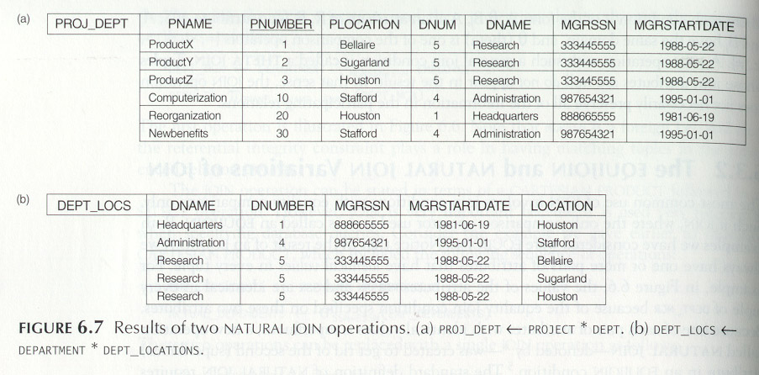

Slide 18
Binary Relational Operations (cont.)
DIVISION Operation
  The division operation is applied to two relations
  R(Z) ÷ S(X), where X subset Z. Let Y = Z - X (and hence Z = X ∪ Y); that is, let Y be the set of attributes of R that are not attributes of S.
  The result of DIVISION is a relation T(Y) that includes a tuple t if tuples t_{R} appear in R with t_{R} [Y] = t, and with t_{R} [X] = t_{s} for every tuple t_{s} in S.
  For a tuple t to appear in the result T of the DIVISION, the values in t must appear in R in combination with every tuple in S.

Slide 19
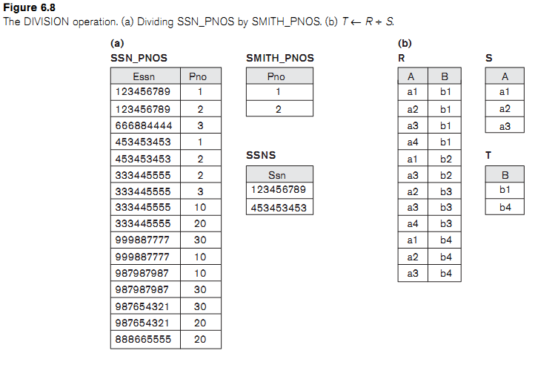

Slide 20
The OUTER JOIN Operation
  In NATURAL JOIN tuples without a matching (or related) tuple are eliminated from the join result. Tuples with null in the join attributes are also eliminated. This amounts to loss of information.
  A set of operations, called outer joins, can be used when we want to keep all the tuples in R, or all those in S, or all those in both relations in the result of the join, regardless of whether or not they have matching tuples in the other relation.
  The left outer join operation keeps every tuple in the first or left relation R in R S; if no matching tuple is found in S, then the attributes of S in the join result are filled or “padded” with null values.
  A similar operation, right outer join, keeps every tuple in the second or right relation S in the result of R S.
  A third operation, full outer join, denoted by keeps all tuples in both the left and the right relations when no matching tuples are found, padding them with null values as needed.

Slide 21
Left Outer Join:
Name | Emp_id | Dept_name
A | E1 | Sales
B | E2 | Purchase
C | E3 | Sales
D | E4 | Finance
Dept_name | Manager
Sales | XYZ
Finance | ABC
Testing | LMN
Name | Emp_id | Dept_name | Manager
A | E1 | Sales | XYZ
B | E2 | Purchase | null
C | E3 | Sales | XYZ
D | E4 | Finance | ABC

Slide 22
Right Outer Join:
Name | Emp_id | Dept_name
A | E1 | Sales
B | E2 | Purchase
C | E3 | Sales
D | E4 | Finance
Dept_name | Manager
Sales | XYZ
Finance | ABC
Testing | LMN
Name | Emp_id | Dept_name | Manager
A | E1 | Sales | XYZ
B | E2 | Sales | XYZ
C | E3 | Finance | ABC
null | null | Testing | LMN

Slide 23
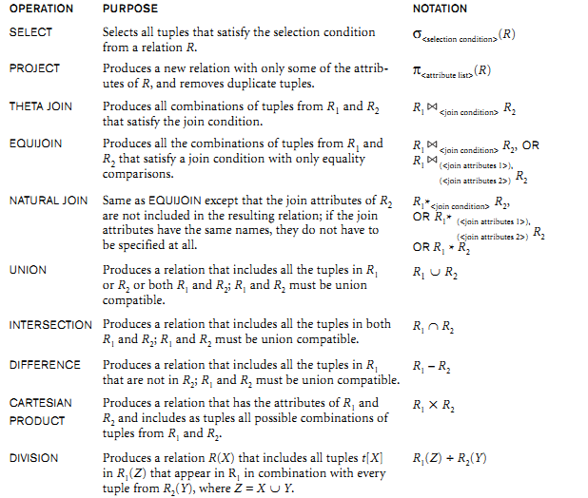
Recap of Relational Algebra Operations

Slide 24
Additional Relational Operations
Aggregate Functions and Grouping
  A type of request that cannot be expressed in the basic relational algebra is to specify mathematical aggregate functions on collections of values from the database.
  Examples of such functions include retrieving the average or total salary of all employees or the total number of employee tuples. These functions are used in simple statistical queries that summarize information from the database tuples.
  Common functions applied to collections of numeric values include SUM, AVERAGE, MAXIMUM, and MINIMUM. The COUNT function is used for counting tuples or values.

Slide 25
Additional Relational Operations (cont.)
Use of the Functional operator ℱ
ℱ_{MAX Salary} (Employee) retrieves the maximum salary value from the Employee relation
ℱ_{MIN Salary} (Employee) retrieves the minimum Salary value from the Employee relation
ℱ_{SUM Salary} (Employee) retrieves the sum of the Salary from the Employee relation
_{DNO} ℱ_{COUNT SSN, AVERAGE Salary} (Employee) groups employees by DNO (department number) and computes the count of employees and average salary per department.[ Note: count just counts the number of rows, without removing duplicates]

Slide 26
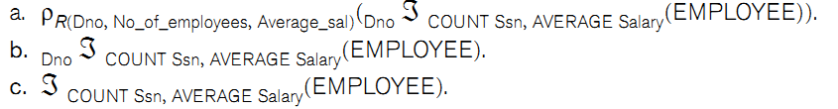
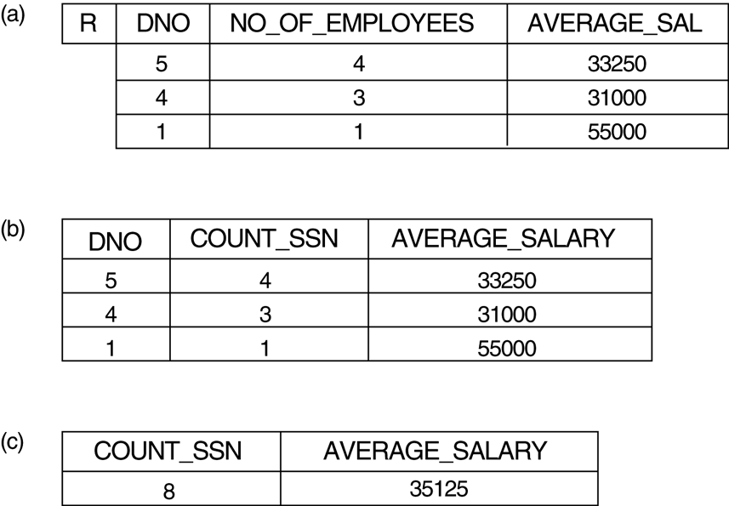
Additional Relational Operations (cont.)

